Slide 1
To Do List Project
Bernard Abraham

Slide 2
Consultant Journey
Week 1,2,3,4,5,6,7 things we learned that were implemented
Skills ive learned

Slide 3
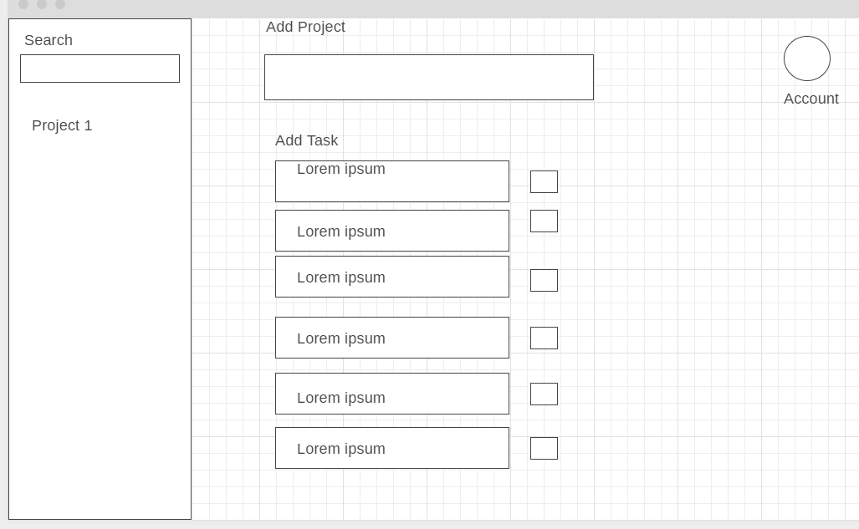
Wireframes
Add tasks as part of a project
Check tasks off
Search Tasks
Manage Account

Slide 4
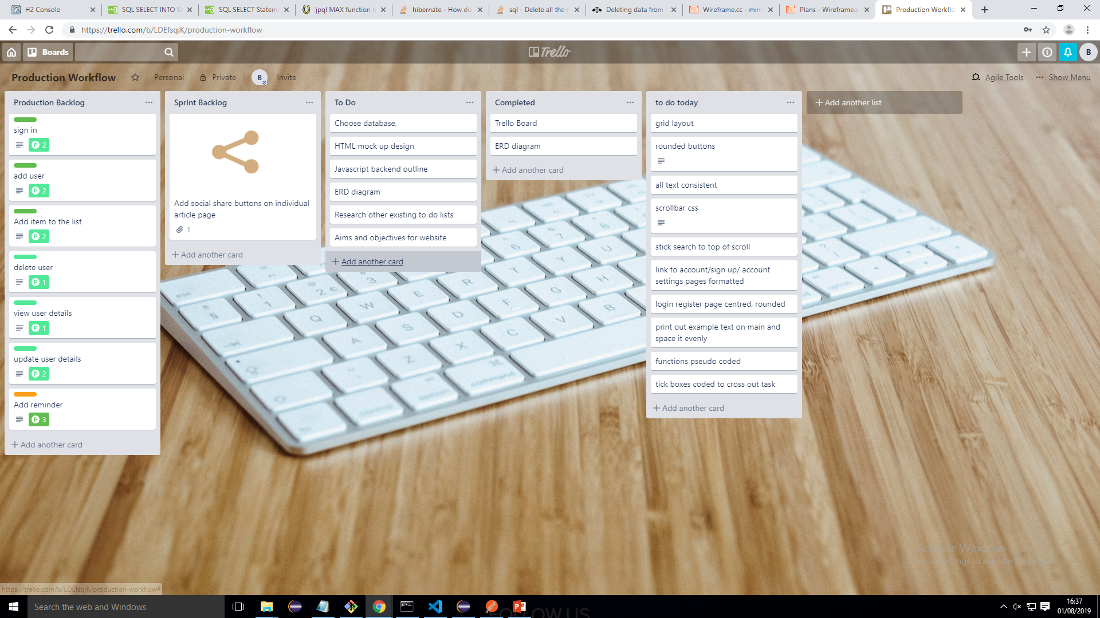
Planning (trello)

Slide 5
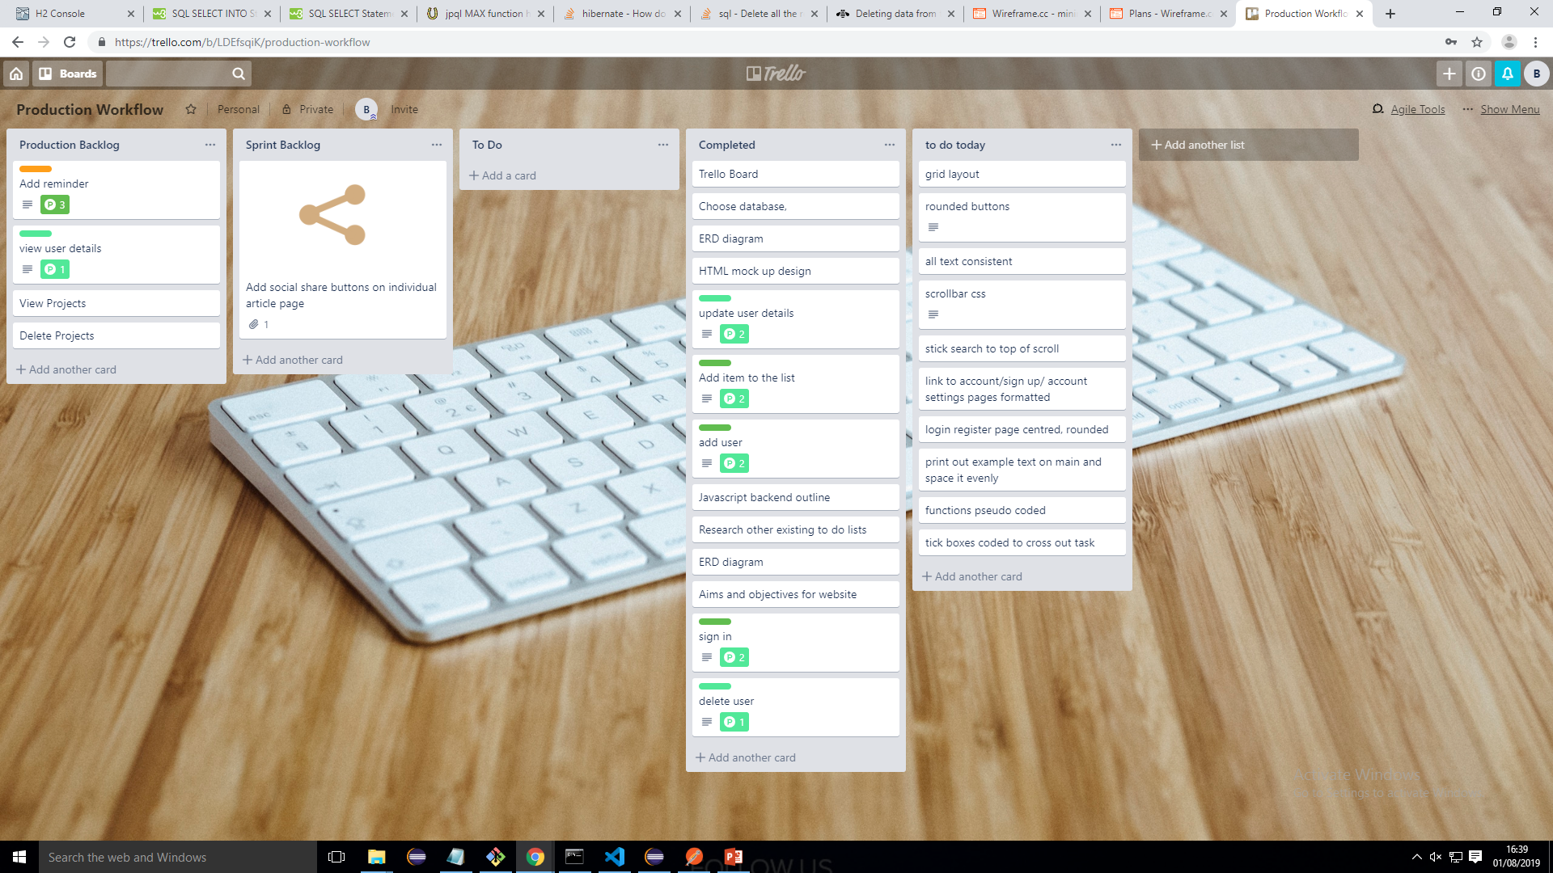
Trello

Slide 6
Database - Erd Diagram
Task
Task
Project
User
Pkey - TaskId
Pkey - ProjectId
Pkey - UserId
Fkey - ProjectId
Fkey - UserId

Slide 7
API

Slide 8
Front End

Slide 9
Project Summary
What went well, What could be Improved, how I’d do it differently

Slide 10
Thankyou for listening
Questions?

